Slide 1
Twenty Years after Mark Weiser's Vision for Ubiquitous Computing - What Next?
Plenary Discussion: 1/27: 5.15pm – 6.15pm
Facilitators: Mahadev Satyanarayanan (Carnegie Mellon University) Roy Want (Intel Labs)

Slide 2
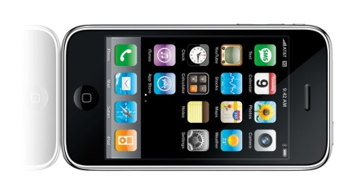
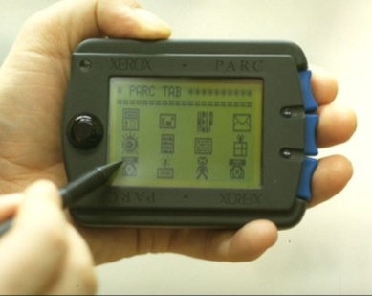
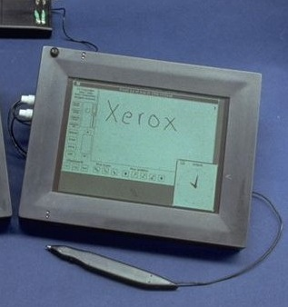
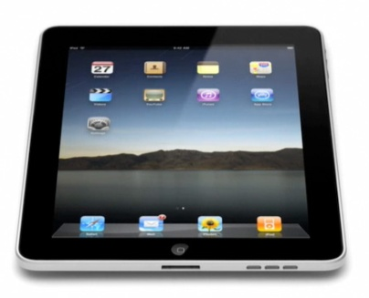
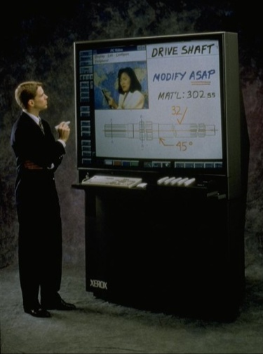
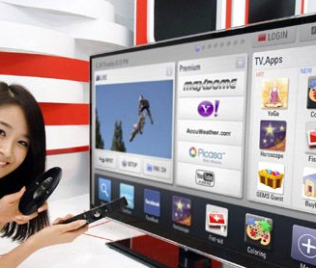
Weiser’s SciAM Article Sept 1991
1991-4
2011
iPhone SmartPhone
ParcTab
ParcPad
iPad or Tablet
SmartTV
LiveBoard

Slide 3
History
1990: no hardware, so PARC had to build it
2000: capable mobile devices began to appear
Now: Lots of devices, all sizes e.g. CES 2011

Slide 4
Questions for discussion
(1) Why is the vision so powerful? (2) How might it be derailed? (3) Things that were not in the vision?
15mins each

Slide 5
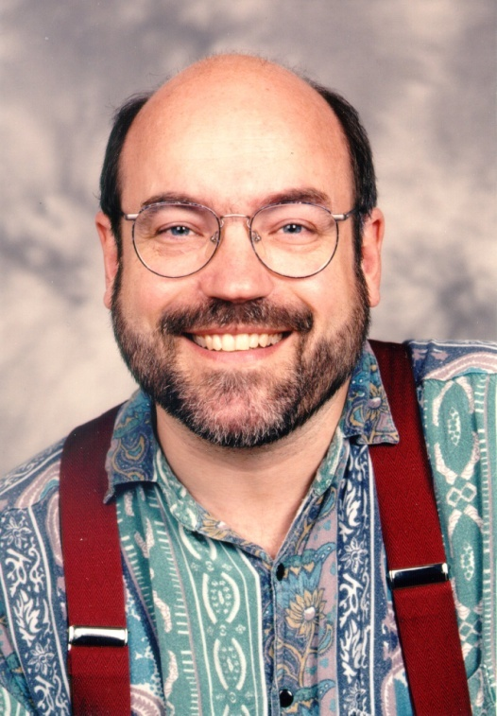
(1) The Power of Weiser’s Vision
“The most profound technologies are those that disappear. They weave themselves into the fabric of every day life, until they are indistinguishable from it.” M. Weiser, 1991
This was the touchstone of Pervasive Computing work. Why has this vision been so powerful & influential? (15 mins).

Slide 6
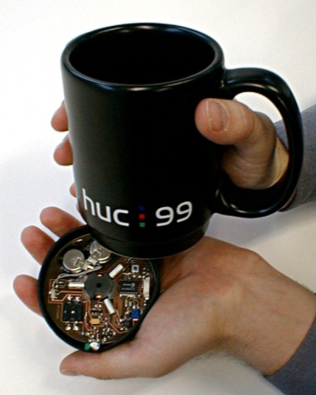
(2)Things that might derail the vision
Who cares how hot? Just Buy Starbucks
Mark Weiser’s vision: -Pop-ups & ads rule our devices
Tower of Babel Problem -So many standards to chose from
Privacy and Security Environment -Viruses and malware pervade everything
(15 mins)

Slide 7
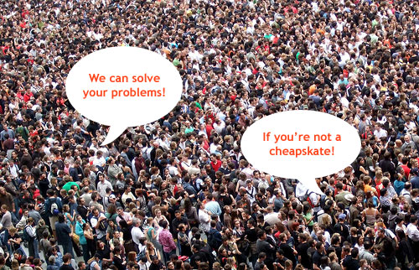
(3) Things that Weiser didn’t Prophesy
World-Wide Web
Crowd sourcing
Social networking
How should the vision be modulated to take these capabilities into account? What else was missed?
(15 mins)

Slide 8
BACK UP

